Slide 1
Supervised Learning Network

Slide 2
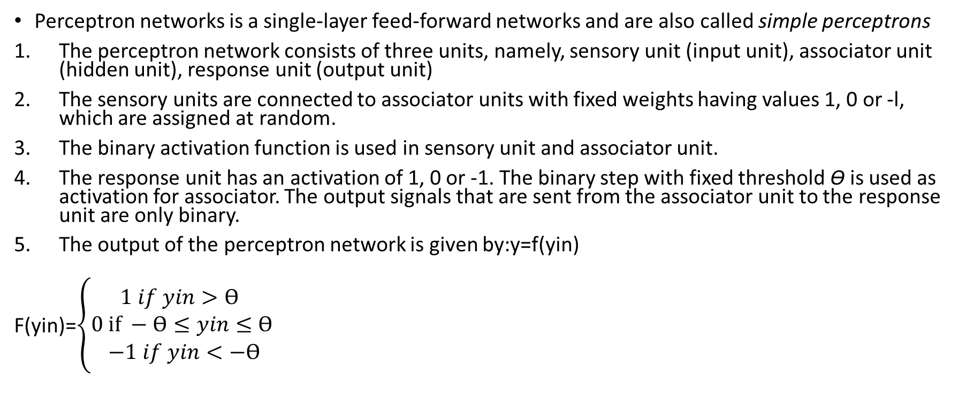
Perceptron Network

Slide 3
Perceptron Network
The perceptron learning rule is used in the weight updation between theassociator unit and the response unit. For each training input, the net will calculate the response and it will determine whether or not an error has occurred.
The error calculation is based on the comparison of the targets with those of the calculated outputs.
The weights on the connections from the units that send the nonzero signal will get adjusted suitably.
The weights will be adjusted on the basis of the learning_rule if an error has occurred for a particular training pattern ,i.e,.
Wi(new) = Wi(old) + α txi
b(new) = b(old) + αt (t is target value)
If no error occurs, there is no weight updation and hence the training process may be stopped

Slide 4
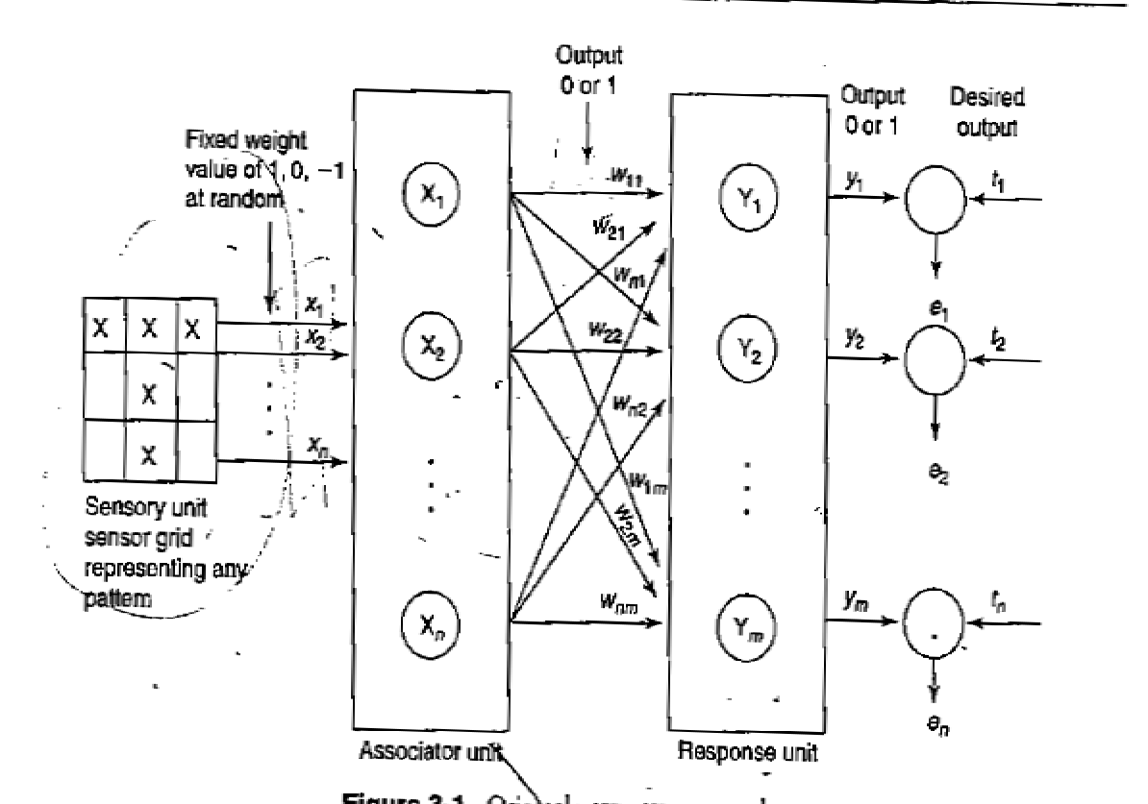

Slide 5
Perceptron Learning Rule

Slide 6
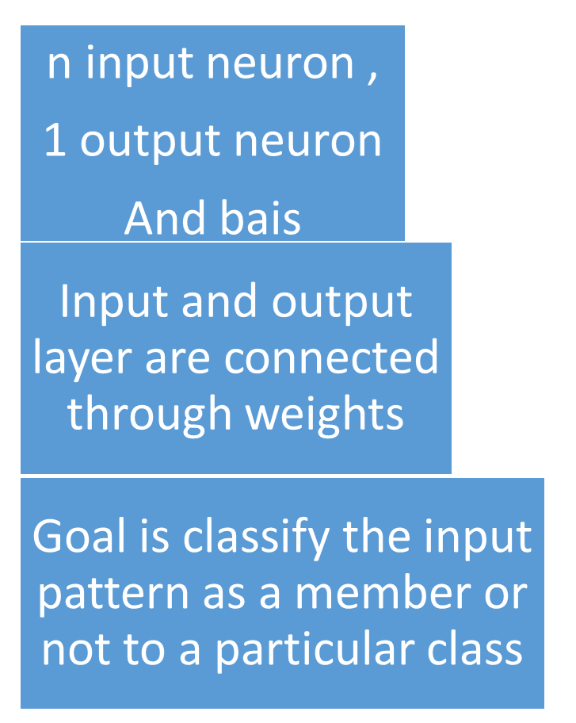
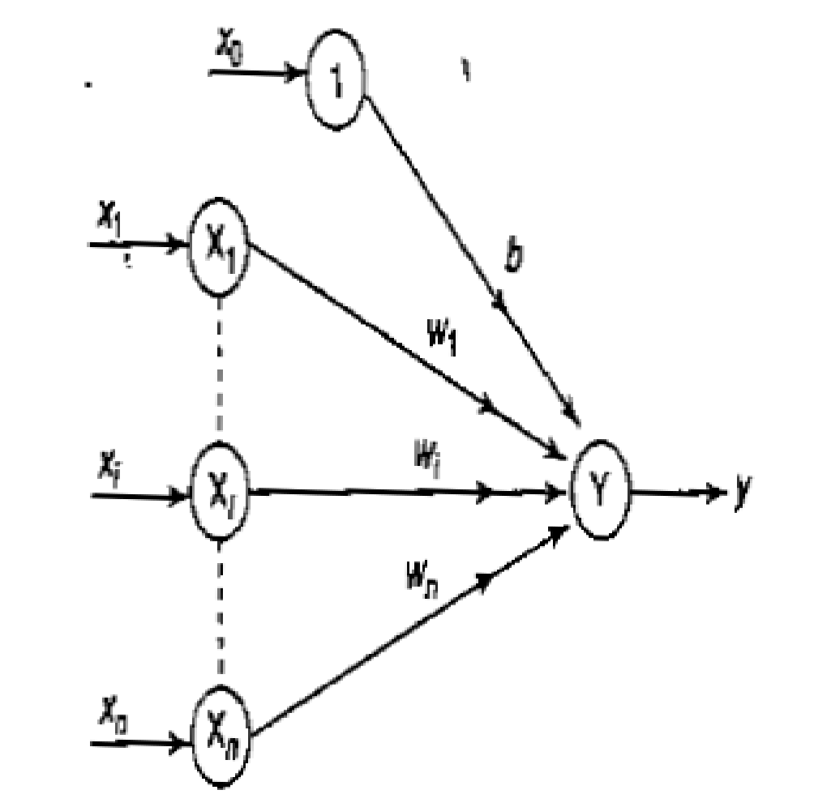
Architecture

Slide 7
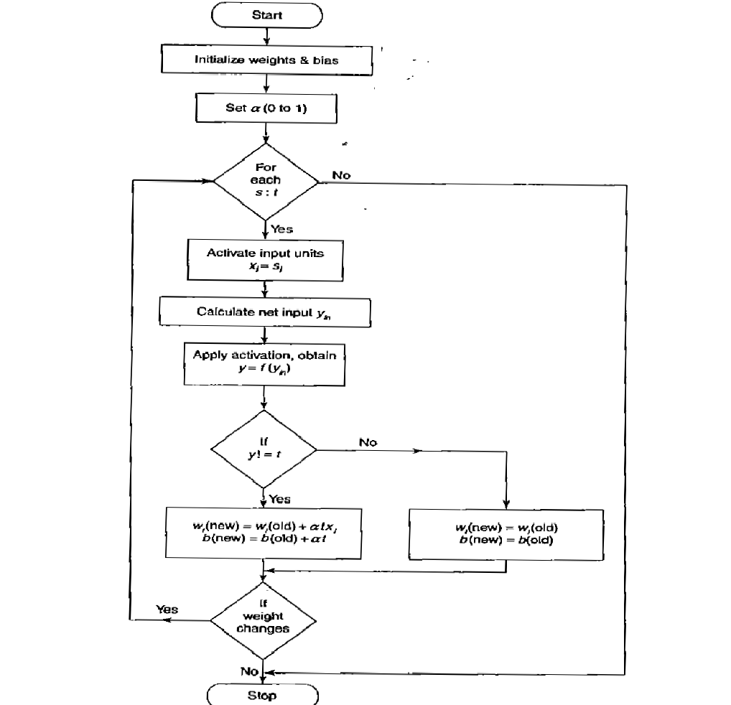

Slide 8
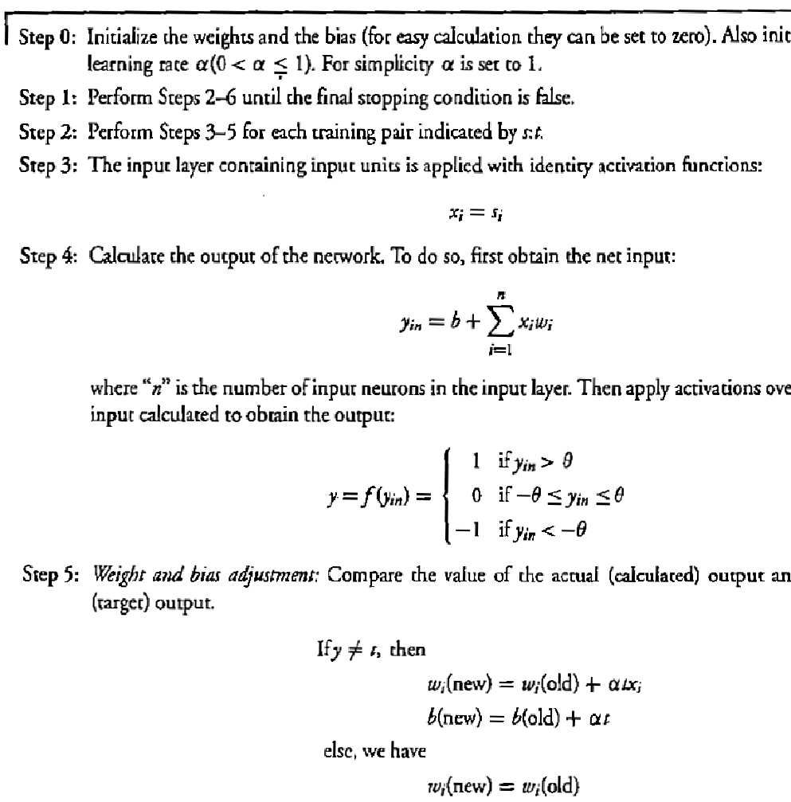

Slide 9
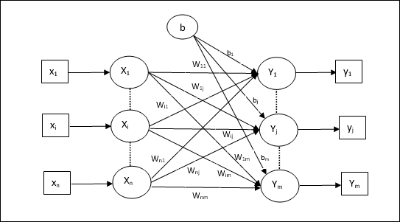
Training Algorithm for Multiple Output Units

Slide 10
Adaptive Linear Neuron(Adaline)
Step 1 − Initialize the following to start the training −
Weights
Bias
Learning rate αα
For easy calculation and simplicity, weights and bias must be set equal to 0 and the learning rate must be set equal to 1.
Step 2 − Continue step 3-8 when the stopping condition is not true.
Step 3 − Continue step 4-6 for every training vector x.
Step 4 − Activate each input unit as follows −
xi=si(i=1ton)
Step 5 − Obtain the net input with the following relation −
yin=b+∑Xiwij
Here ‘b’ is bias and ‘n’ is the total number of input neurons.
Step 6 − Apply the following activation function to obtain the final output for each output unit j = 1 to m
Y=f(yin)
Step 7 − Adjust the weight and bias for x = 1 to n and j = 1 to m as follows −
Case − if y_{j} ≠ t_{j} then,
wij(new)=wij(old)+αtjxiwij(new)=wij(old)+αtjxi
bj(new)=bj(old)+αtj

Slide 11
Adaptive Linear Neuron(Adaline)
The units with linear activation function are called linear units. A network with a single linear unit is called an Adaline (adaptive linear neuron). That is, in an Adaline, the input-output relationship is linear.
Adaline uses bipolar activation for its input signals and its target output. The weights between the input and the output are adjustable. The bias in Adaline acts like an adjustable weight, whose connection is from a unit with activations being always 1.
Adaline is a net which has only one output unit. The Adaline network may be trained using delta rule. The delta rule may also be called as least mean square (LMS) rule .This learning rule is found to minimize the mean squared error between the activation and the target value.

Slide 12
Delta Rule for Single Output Unit
Delta Rule is derived from the gradient-descent method, converging only to a asymptotically to a solution unlike perceptron learning rule.
It minimizes the difference between the net input to the output unit and target value.
The aim is to minimize the error over all training patterns.
The delta rule for adjusting the weight of the ith pattern(i=1 to n) is\
∆W_{i}=α (t-y_{in})x_{i}

Slide 13
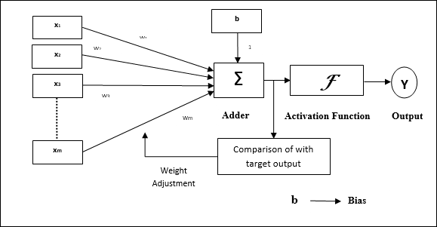
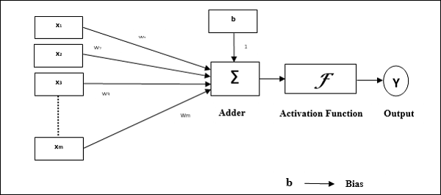
Adaline Model
Perceptron

Slide 14
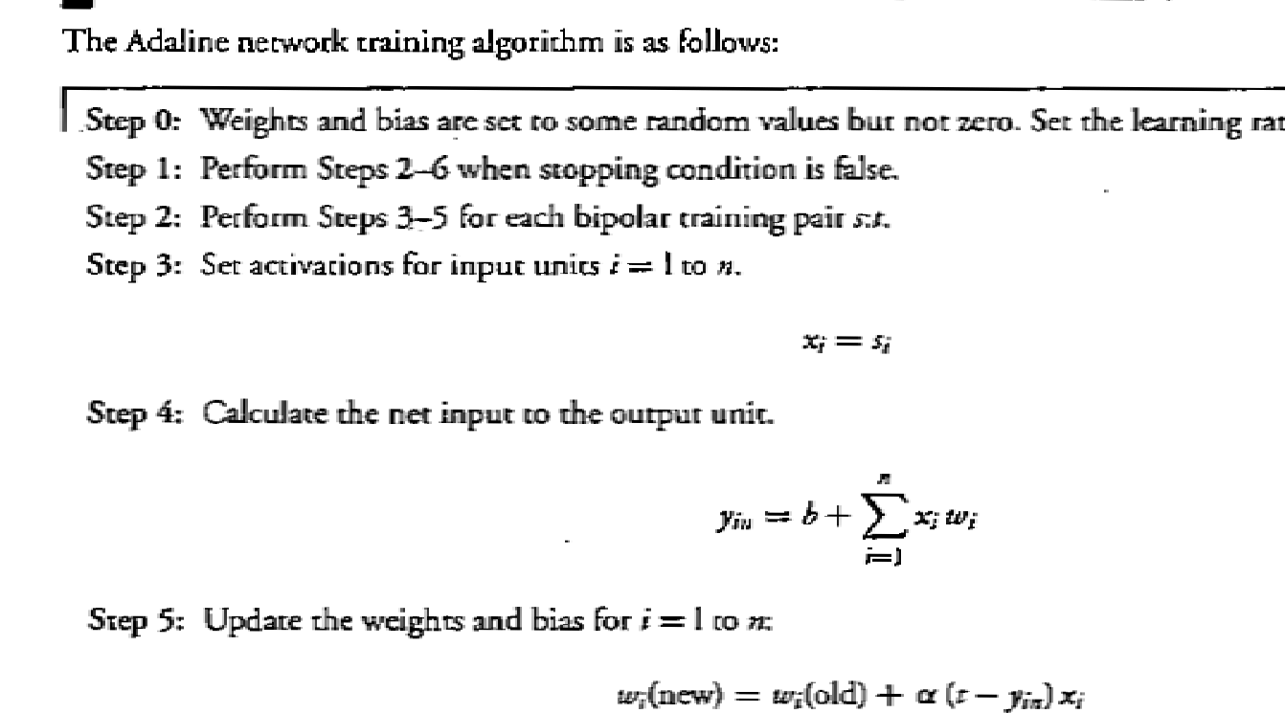

Slide 15
Multiple Adaptive Linear Neurons
The multiple adaptive linear neurons (Madaline) model consists of many Adaline with a single output unit whose value is based on certain selection rules.
It may use majority vote rule. On using this rule,output would have as answer either true or false. On the other hand, if AND rule is used, the output is true if and only if both the inputs are true, and so on. The weights that are connected from the Adaline layer to the Madaline layer are fixed, positive and possess equal values. The weights between the input layer and the Adaline layer are adjusted during the training process.
The Adaline and Madaline layer neurons have a bias of excitation “1" connected to them.

Slide 16
Madaline
Madaline which stands for Multiple Adaptive Linear Neuron, is a network which consists of many Adalines in parallel. It will have a single output unit. Some important points about Madaline are as follows −
It is just like a multilayer perceptron, where Adaline will act as a hidden unit between the input and the Madaline layer.
The weights and the bias between the input and Adaline layers, as in we see in the Adaline architecture, are adjustable.
The Adaline and Madaline layers have fixed weights and bias of 1.
Training can be done with the help of Delta rule.

Slide 17
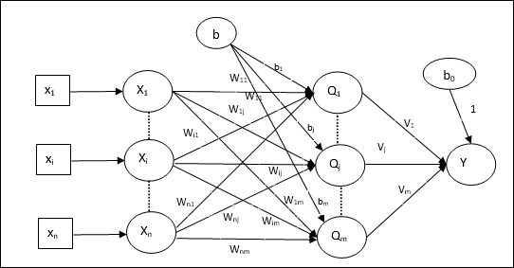
Madaline Architecture
The architecture of Madaline consists of “n” neurons of the input layer, “m”neurons of the Adaline layer, and 1 neuron of the Madaline layer. The Adaline layer can be considered as the hidden layer as it is between the input layer and the output layer, i.e. the Madaline layer.

Slide 18
Algorithm Madaline
xi=si(i=1 to n)

Slide 19
Back Propagation Network
Applied to Multi Layer feed-forward network consisting of processing elements with continuous differentiable activation function.
As hidden layer are increased the network training become more complex.
The difficulty is calculating the weight of hidden layer in an efficient way that result in minimizing output error
At hidden layer , there is no direct information of error therefore other techniques should be used to calculate an error at the hidden layer which minimize output error that is the ultimate goal.
The training of BPN is done in three stage
feed-forward of input training pattern
Calculation and back propagation of error
Updating weight

Slide 20
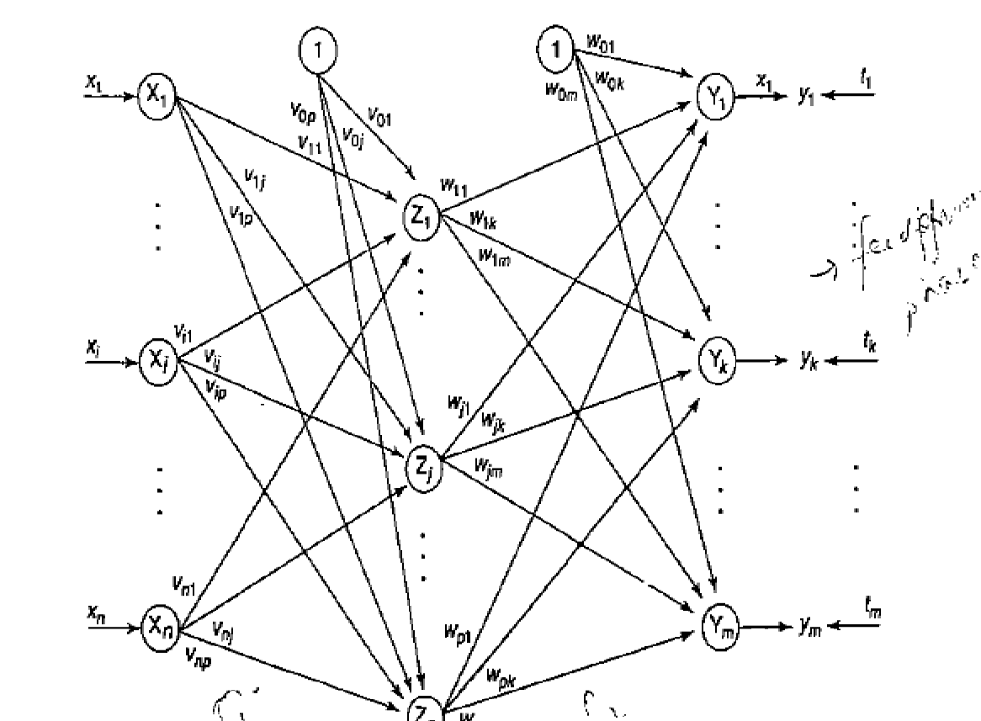
Architecture
A BPN is a multilayer feed-forward neural network consisting of an input layer a hidden layer and an output layer

Slide 21
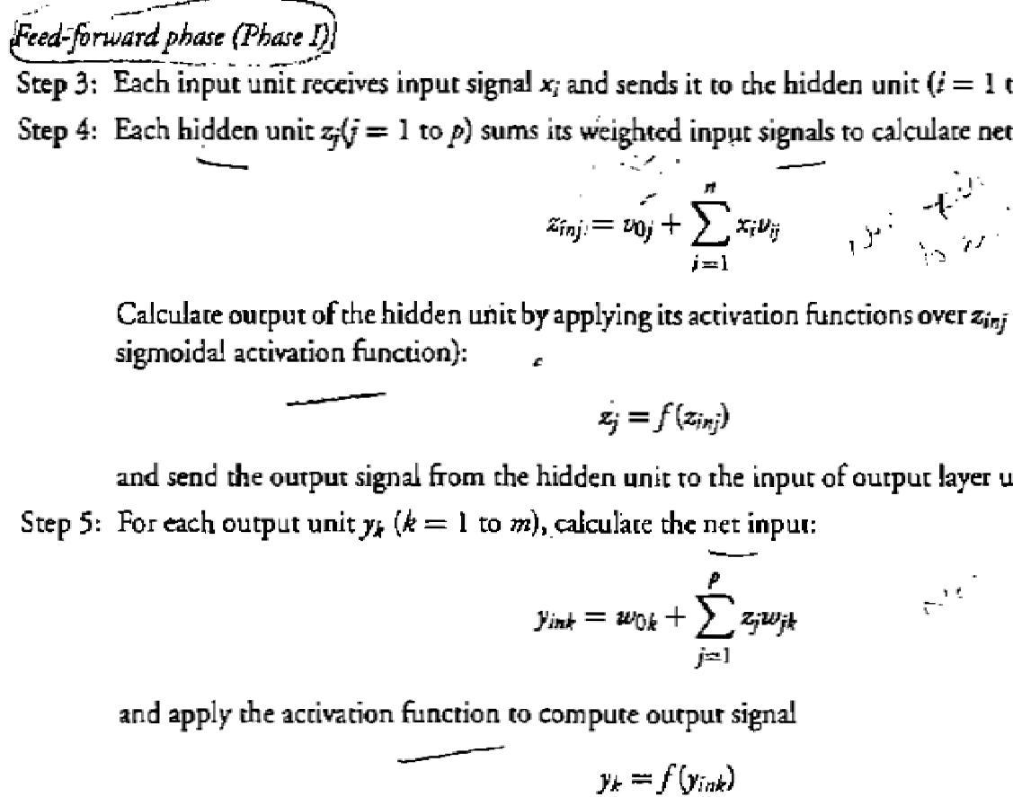

Slide 22
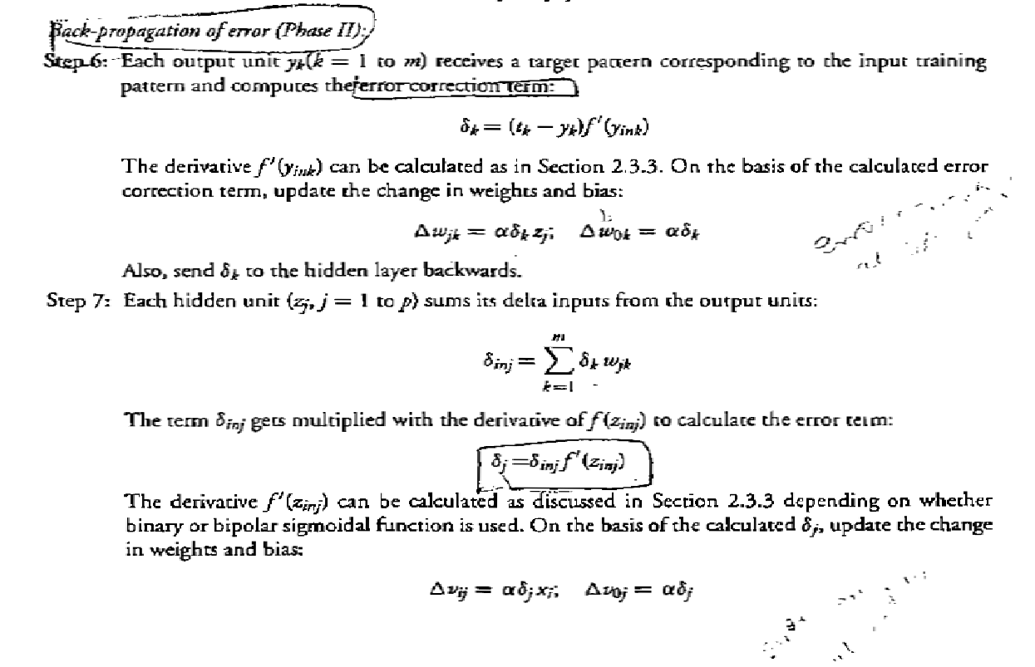

Slide 23
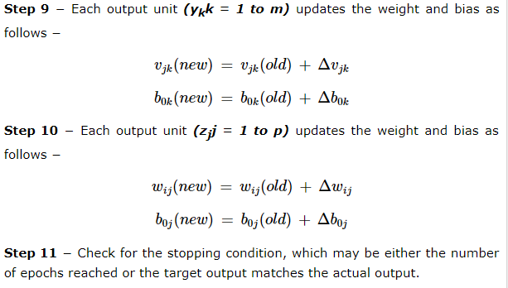

Slide 24
Unsupervised Learning
When a new input pattern is applied, then the neural network gives an output response indicating the class to which input pattern belongs.
In this, there would be no feedback from the environment as to what should be the desired output and whether it is correct or incorrect.
Hence, in this type of learning the network itself must discover the patterns, features from the input data and the relation for the input data over the output.

Slide 25
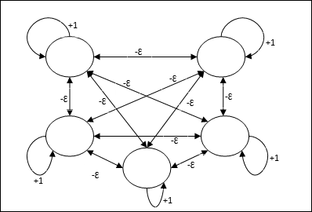
Max Net
This is also a fixed weight network, which serves as a subnet for selecting the node having the highest input. All the nodes are fully interconnected and there exists symmetrical weights in all these weighted interconnections

Slide 26
Max Net
It uses the mechanism which is an iterative process and each node receives inhibitory inputs from all other nodes through connections. The single node whose value is maximum would be active or winner and the activations of all other nodes would be inactive. Max Net uses identity activation function with
F(x)= x if x>0
F(x)=0 if x<= 0

